Slide 1
The Basics of Capital Budgeting: Evaluating Cash Flows
CHAPTER 10
© 2020 Cengage Learning. All Rights Reserved. May not be copied, scanned, or duplicated, in whole or in part, except for use as permitted in a license distributed with a certain product or service or otherwise on a password-protected website for classroom use.

Slide 2
Topics
Overview and “vocabulary”
Methods
NPV
IRR, MIRR
Profitability Index
Payback, discounted payback
Unequal lives
Economic life
Optimal capital budget

Slide 3
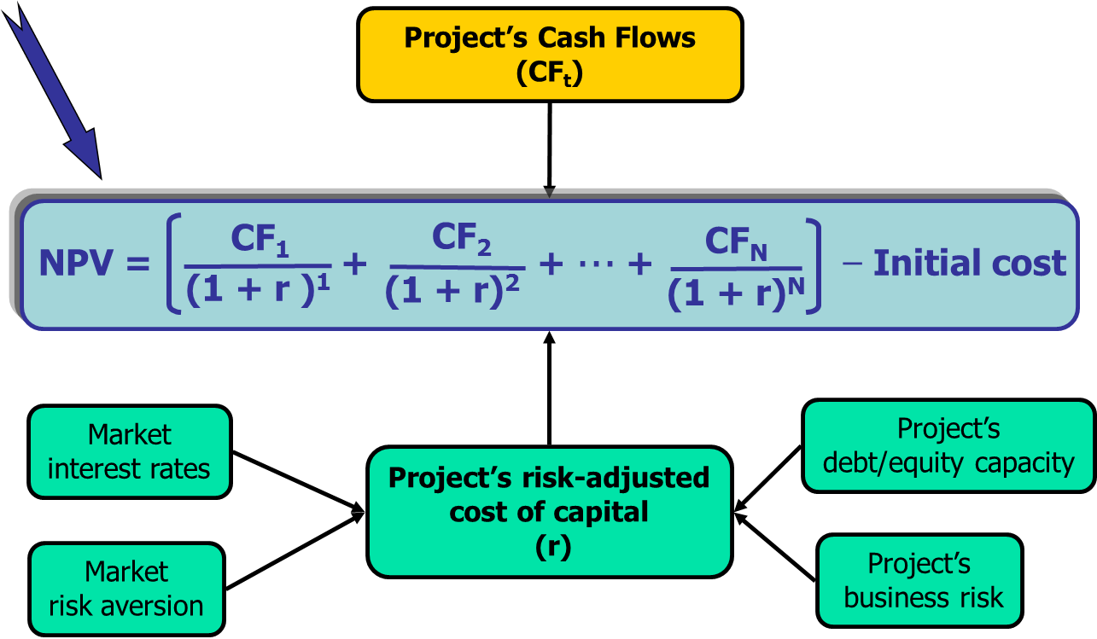
The Big Picture: The Net Present Value of a Project

Slide 4
What is capital budgeting?
Analysis of potential projects.
Long-term decisions; involve large expenditures.
Very important to firm’s future.

Slide 5
Steps in Capital Budgeting
Estimate cash flows (inflows & outflows).
Assess risk of cash flows.
Determine r = WACC for project.
Evaluate cash flows.

Slide 6
Capital Budgeting Project Categories
Replacement to continue profitable operations
Replacement to reduce costs
Expansion of existing products or markets
Expansion into new products/markets
Contraction decisions
Safety and/or environmental projects
Mergers
Other

Slide 7
Independent versus Mutually Exclusive Projects
Projects are:
independent, if the cash flows of one are unaffected by the acceptance of the other.
mutually exclusive, if the cash flows of one can be adversely impacted by the acceptance of the other.

Slide 8
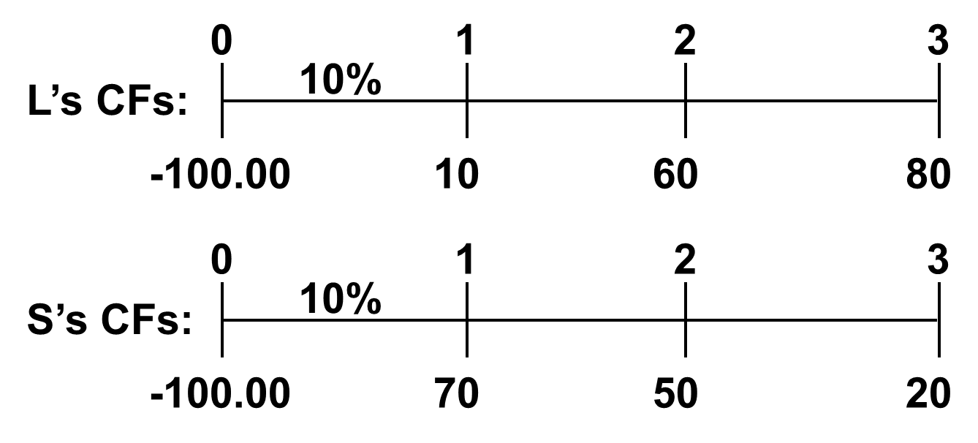
Cash Flows for Franchises L and S

Slide 9
NPV: Sum of the PVs of All Cash Flows

Slide 10
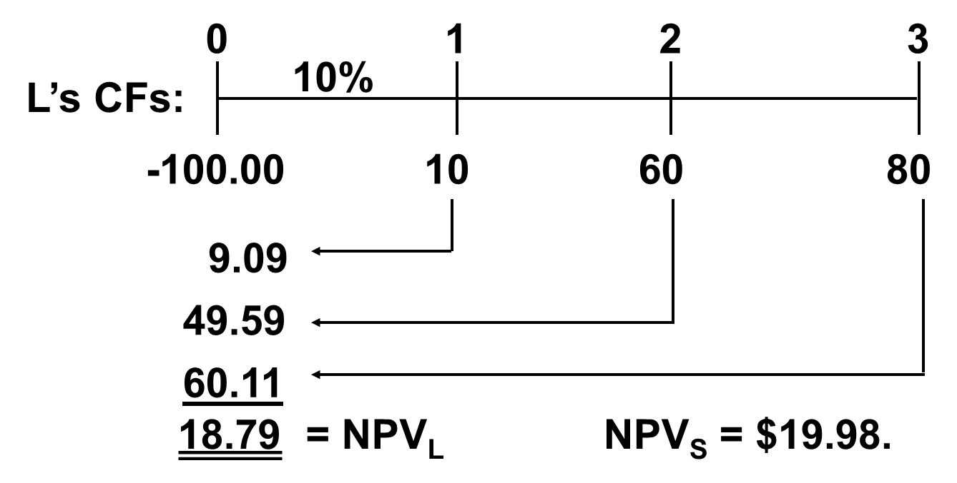
What’s Franchise L’s NPV?

Slide 11
Calculator Solution: Enter Values in CFLO Register for L

Slide 12
Rationale for the NPV Method
NPV = PV inflows – Cost
This is net gain in wealth, so accept project if NPV > 0.
Choose between mutually exclusive projects on basis of higher positive NPV. Adds most value.

Slide 13
Using the NPV measure, which franchise(s) should be accepted?
If Franchises S and L are mutually exclusive, accept S because NPV_{s} > NPV_{L}.
If S & L are independent, accept both; NPV > 0.
NPV is dependent on cost of capital.

Slide 14
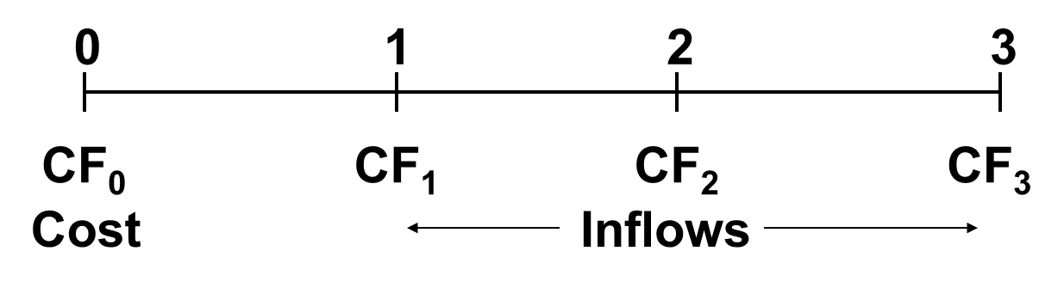
Internal Rate of Return: IRR
IRR is the discount rate that forces
PV inflows = cost. This is the same
as forcing NPV = 0.

Slide 15
NPV: Enter r, solve for NPV.

Slide 16
IRR: Enter NPV = 0, Solve for IRR
IRR is an estimate of the project’s rate of return, so it is comparable to the YTM on a bond.

Slide 17
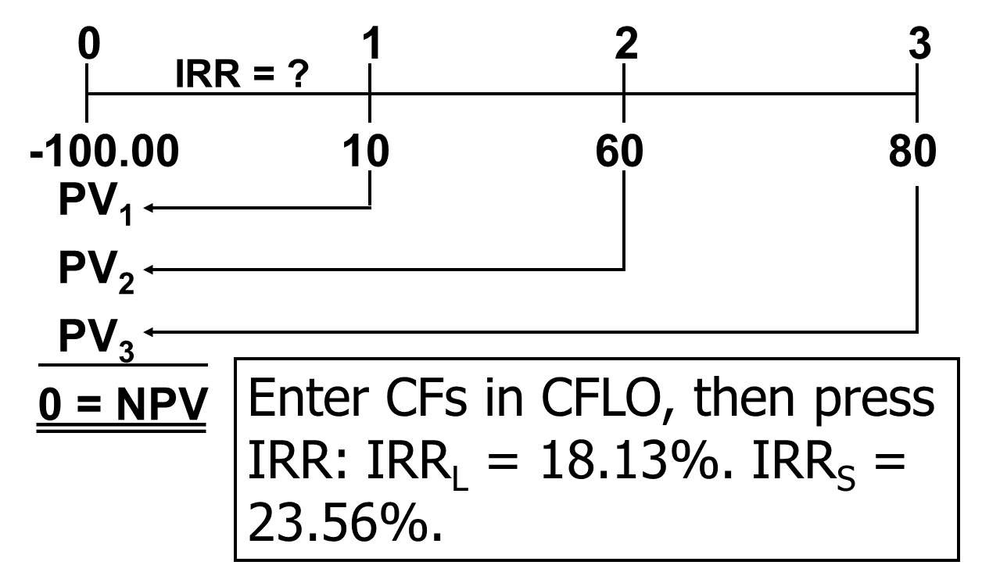
What’s Franchise L’s IRR?

Slide 18
How is the IRR on a project related to the yield to maturity (YTM) on a bond?
IRR: The discount rate that forces the present value of a project’s expected future cash flows to equal the initial cash flow.
YTM: The discount rate that forces the present value of a bondscash flows (i.e., coupons and maturity value) to equal the price of the bond.

Slide 19
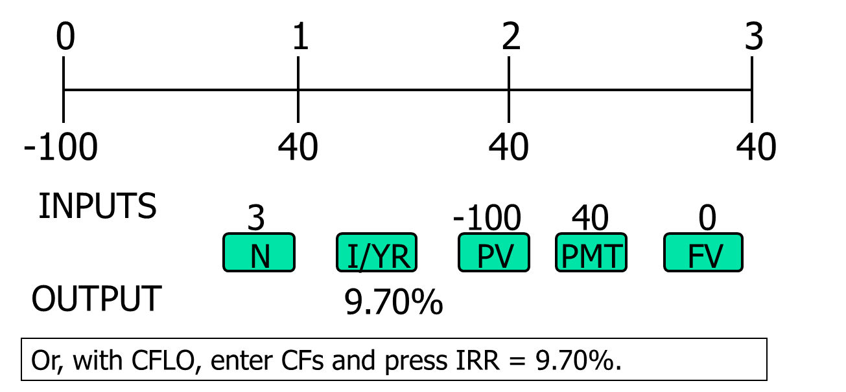
Finding IRR if CFs are Constant (Use the Excel RATE function as though the project were a bond.)
IRR = RATE(3,40,100) = 9.7%
Alternatively:

Slide 20
Rationale for the IRR Method
If IRR > r, then the project’s rate of return is greater than its cost-- some return is left over to boost stockholders’ returns.
Example:
r= 10%, IRR = 15%.
So this project adds extra return to shareholders.

Slide 21
Decisions on Franchises S and L per IRR
If S and L are independent, accept both: IRR_{S} > r and IRR_{L} > r.
If S and L are mutually exclusive, accept S because IRR_{S} > IRR_{L}.
IRR is not dependent on the cost of capital used.

Slide 22
Construct NPV Profiles
Enter CFs in CFLO and find NPV_{L} and NPV_{S} at different discount rates:
r | NPV_{L} | NPV_{S}
0 | 50 | 40
5 | 33 | 29
10 | 19 | 20
15 | 7 | 12
20 | (4) | 5

Slide 23
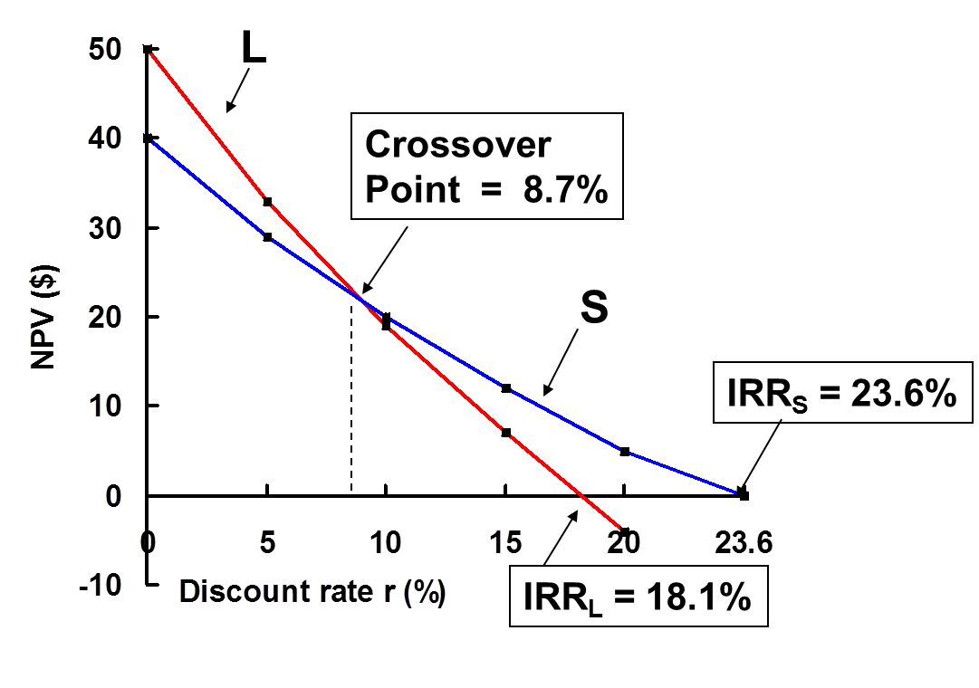
NPV Profile

Slide 24
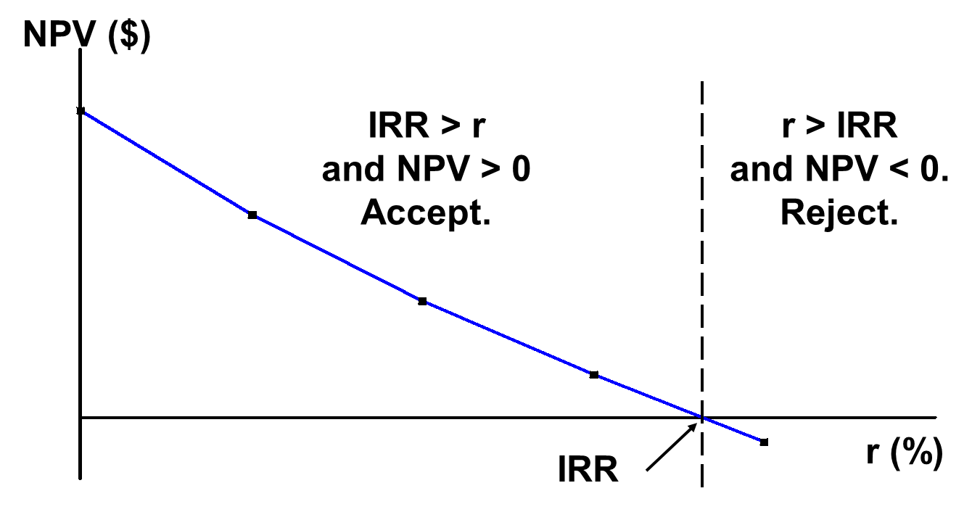
NPV and IRR: No conflict for independent projects.

Slide 25
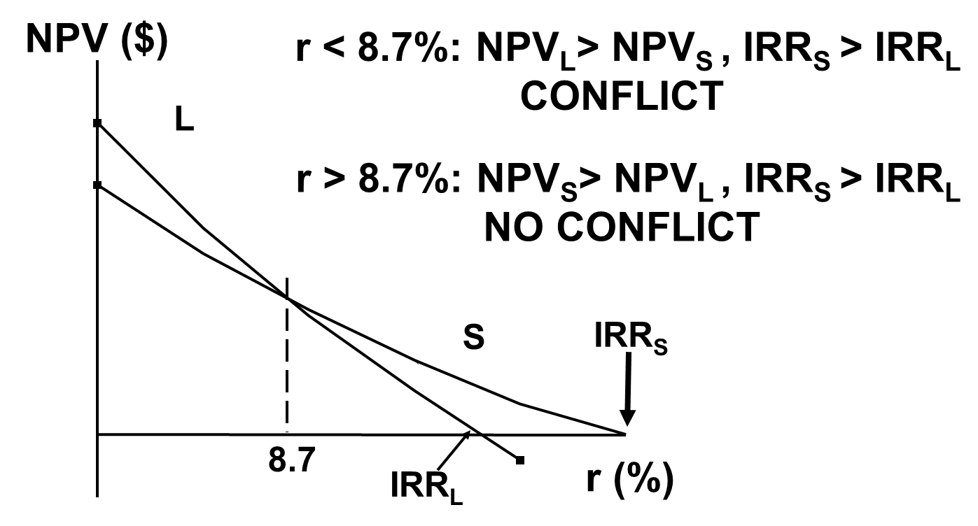
Mutually Exclusive Projects

Slide 26
To Find the Crossover Rate
Find cash flow differences between the projects. See data at beginning of the case.
Enter these differences in CFLO register, then press IRR. Crossover rate = 8.68%, rounded to 8.7%.
Can subtract S from L or vice versa and consistently, but easier to have first CF negative.
If profiles don’t cross, one project dominates the other.

Slide 27
Two Reasons NPV Profiles Cross
Size (scale) differences. Smaller project frees up funds at t = 0 for investment. The higher the opportunity cost, the more valuable these funds, so high r favors small projects.
Timing differences. Project with faster payback provides more CF in early years for reinvestment. If r is high, early CF especially good, NPV_{S} > NPV_{L}.

Slide 28
Modified Internal Rate of Return (MIRR)
MIRR is the discount rate that causes the PV of a project’s terminal value (TV) to equal the PV of costs.
TV is found by compounding inflows at WACC.
Thus, MIRR assumes cash inflows are reinvested at WACC.

Slide 29
MIRR for Franchise L (r = 10%) using the Excel RATE function.
 | A | B | C | D
1 | r = | 10%
2 | Year | Year | Year | Year
3 | 0 | 1 | 2 | 3
4 | (100) | 10 | 60 | 80
5
6 | MIRR = | MIRR(A4:D4,B4,B4)
7 | MIRR = | 16.50%

Slide 30
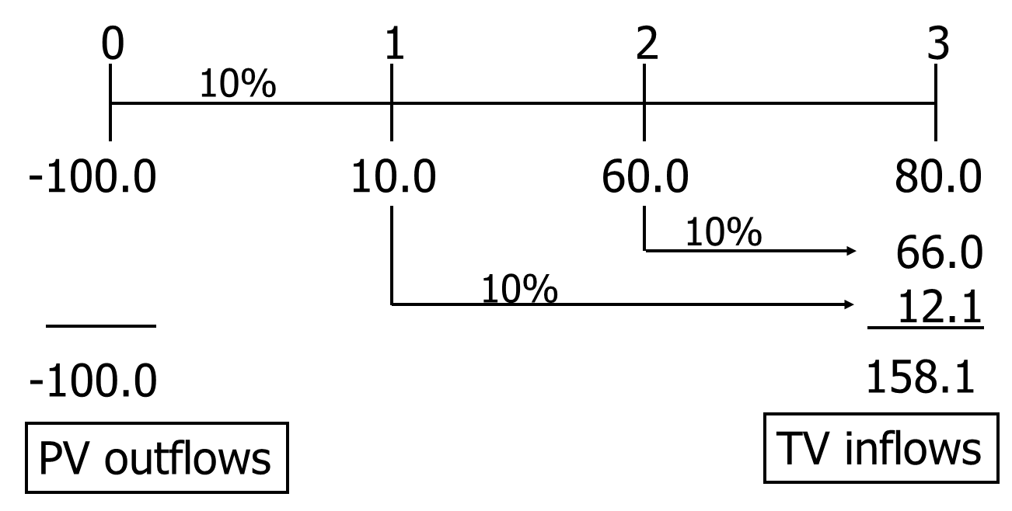
Alternative Method to Find MIRR for Franchise L: First, find PV and TV (r = 10%).

Slide 31
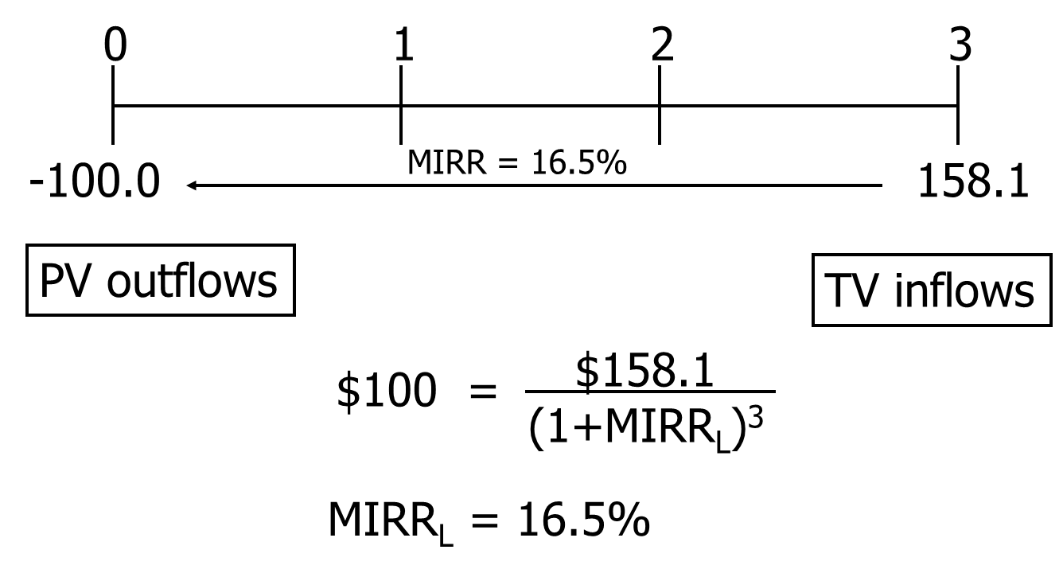
Second, find discount rate that equates PV and TV.

Slide 32
To find MIRR with financial calculator: (1 of 2)
Step 1, Find PV of inflows
First, enter cash inflows in CFLO register:
CF₀ = 0, CF₁ = 10, CF₂ = 60, CF₃ = 80
Second, enter I/YR = 10.
Third, find PV of inflows: Press NPV = 118.78
Step 2, Find TV of PV of inflows from Step 1.
Enter PV = -118.78, N = 3, I/YR = 10, PMT = 0.
Press FV = 158.10 = FV of inflows.

Slide 33
To find MIRR with financial calculator: (2 of 2)
Step 3, Find PV of outflows.
For this problem, there is only one outflow:
CF₀ = -100, so the PV of outflows is -100.
For other problems there may be negative cash flows for several years, and you must find the present value for all negative cash flows.
Step 4, Find “IRR” of TV of inflows and PV of outflows.
Enter FV = 158.10, PV = -100, PMT = 0, N = 3.
Press I/YR = 16.50% = MIRR.

Slide 34
Profitability Index
The profitability index (PI) is the present value of future cash flows divided by the initial cost.
It measures the “bang for the buck.”

Slide 35
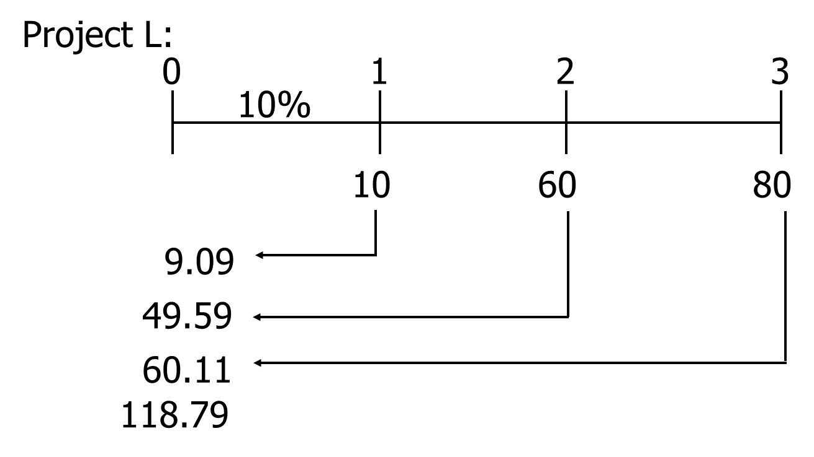
Franchise L’s PV of Future Cash Flows

Slide 36
Franchise L’s Profitability Index

Slide 37
What is the payback period?
The number of years required to recover a project’s cost,
or how long does it take to get the business’s money back?

Slide 38
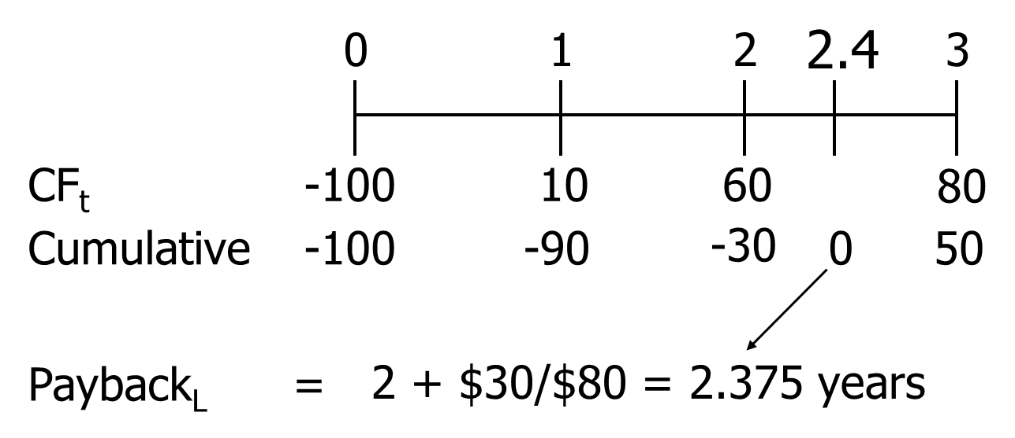
Payback for Franchise L

Slide 39
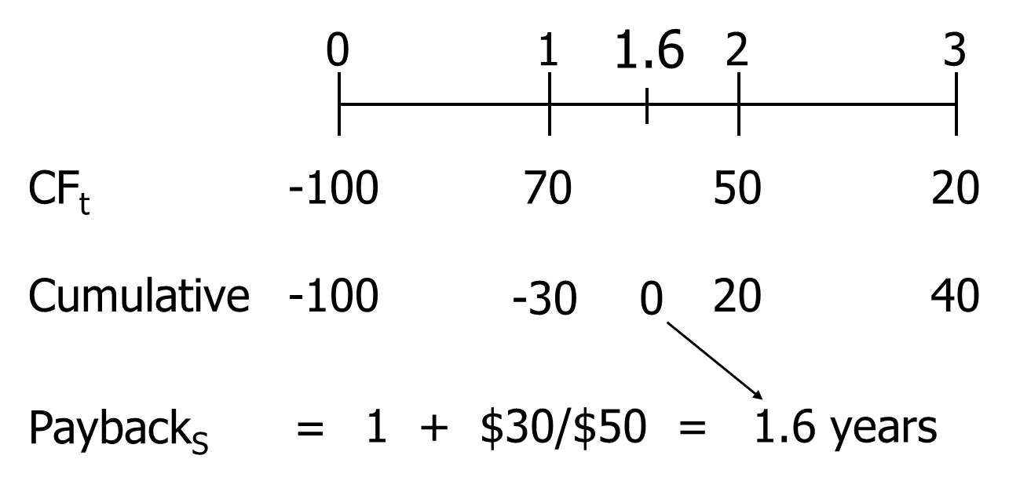
Payback for Franchise S

Slide 40
Strengths and Weaknesses of Payback
Strengths:
Provides an indication of a project’s risk and liquidity.
Easy to calculate and understand.
Weaknesses:
Ignores the TVM.
Ignores CFs occurring after the payback period.
No specification of acceptable payback.

Slide 41
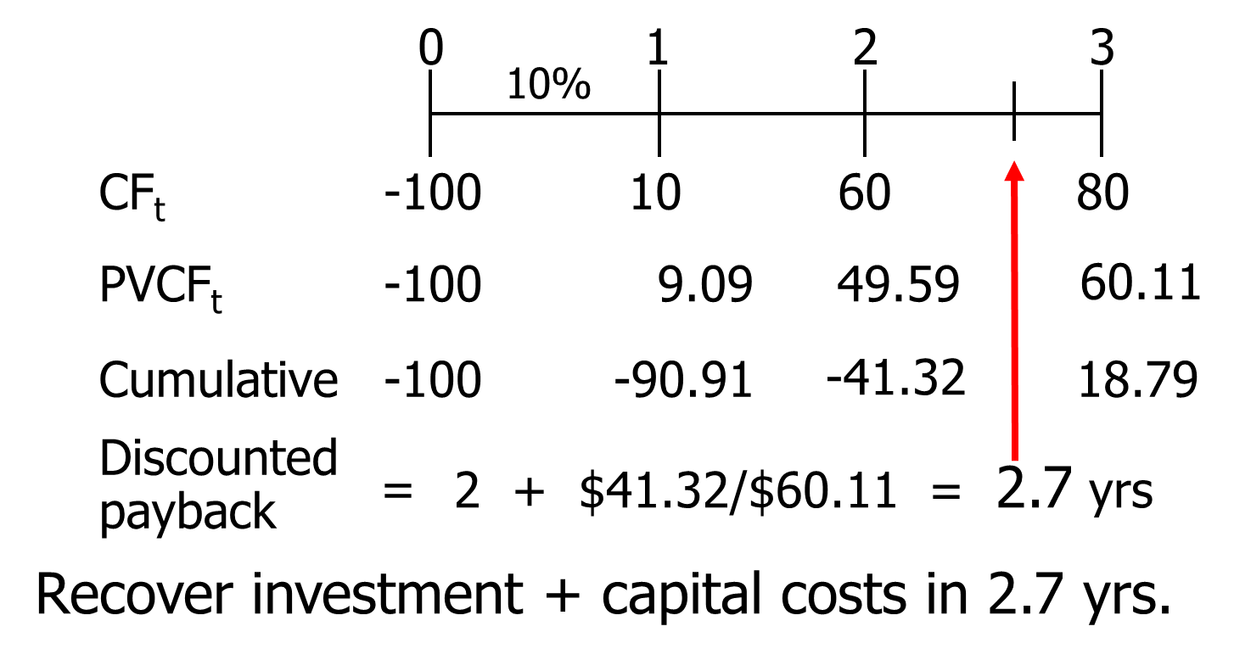
Discounted Payback: Uses Discounted CFs

Slide 42
Normal vs. Nonnormal Cash Flows
Normal Cash Flow Project:
Cost (negative CF) followed by a series of positive cash inflows.
One change of signs.
Nonnormal Cash Flow Project:
Two or more changes of signs.
Most common: Cost (negative CF), then string of positive CFs, then cost to close project.
For example, nuclear power plant or strip mine.

Slide 43
Inflow (+) or Outflow (-) in Year
0 | 1 | 2 | 3 | 4 | 5 | N | NN
- | + | + | + | + | + | N
- | + | + | + | + | - |  | NN
- | - | - | + | + | + | N
+ | + | + | - | - | - | N
- | + | + | - | + | - |  | NN

Slide 44
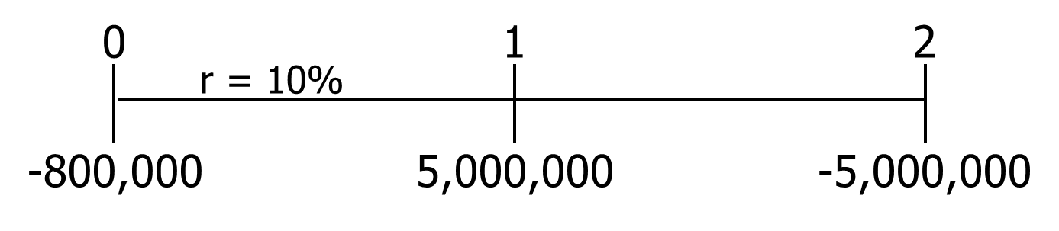
Pavilion Project: NPV and IRR?
Enter CFs in CFLO, enter I/YR = 10.
NPV = -386,777
IRR = ERROR. Why?

Slide 45
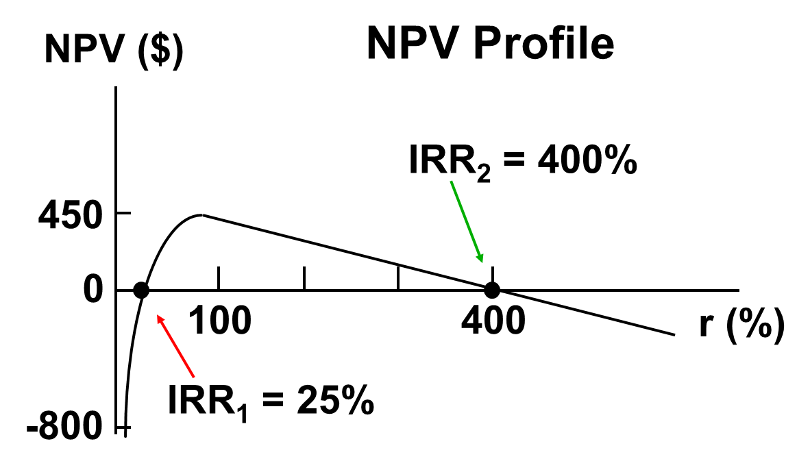
Nonnormal CFs—Two Sign Changes, Two IRRs

Slide 46
Logic of Multiple IRRs
At very low discount rates, the PV of CF₂ is large & negative, so NPV < 0.
At very high discount rates, the PV of both CF₁ and CF₂ are low, so CF₀ dominates and again NPV < 0.
In between, the discount rate hits CF₂ harder than CF₁, so NPV > 0.
Result: 2 IRRs.

Slide 47

Finding Multiple IRRs with Calculator
1. Enter CFs as before.
2. Enter a “guess” as to IRR by storing the guess. Try 10%:
10 STO
IRR = 25% = lower IRR
(See next slide for upper IRR)

Slide 48
Finding Upper IRR with Calculator
Now guess large IRR, say, 200:
200 STO
IRR = 400% = upper IRR

Slide 49
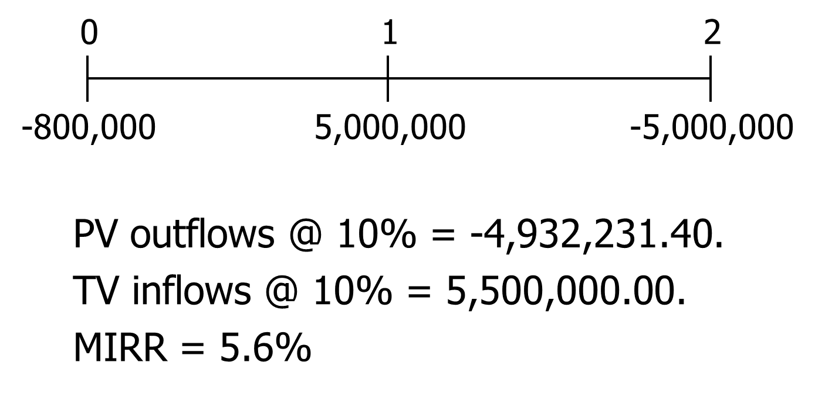
When there are nonnormal CFs and more than one IRR, use MIRR.

Slide 50
Accept Project P?
NO. Reject because MIRR = 5.6% < r = 10%.
Also, if MIRR < r, NPV will be negative: NPV = -$386,777.

Slide 51
Projects T (for two years) and F (for four years) are mutually exclusive and will be repeated; r = 10%.
0
1
2
3
4
60
33.5
60
33.5
33.5
33.5
T: -100
F: -100
Note: CFs shown in $ Thousands

Slide 52
NPV_{F} > NPV_{T}, but which is better? T can be repeated!
 | T | F
CF₀ | -100 | -100
CF₁ | 60 | 33.5
N_{J} | 2 | 4
I/YR | 10 | 10
NPV | 4.132 | 6.190

Slide 53
Equivalent Annual Annuity Approach (EAA)
Convert the PV into a stream of annuity payments with the same PV.
T: N=2, I/YR=10, PV=-4.132, FV = 0. Solve for PMT = EAA_{T} = $2.38.
F: N=4, I/YR=10, PV=-6.190, FV = 0. Solve for PMT = EAA_{F} = $1.95.
T has higher EAA, so it is a better project.

Slide 54
Replacement Chain
Note that Project T could be repeated after 2 years to generate additional profits.
Use replacement chain to put on common life.

Slide 55
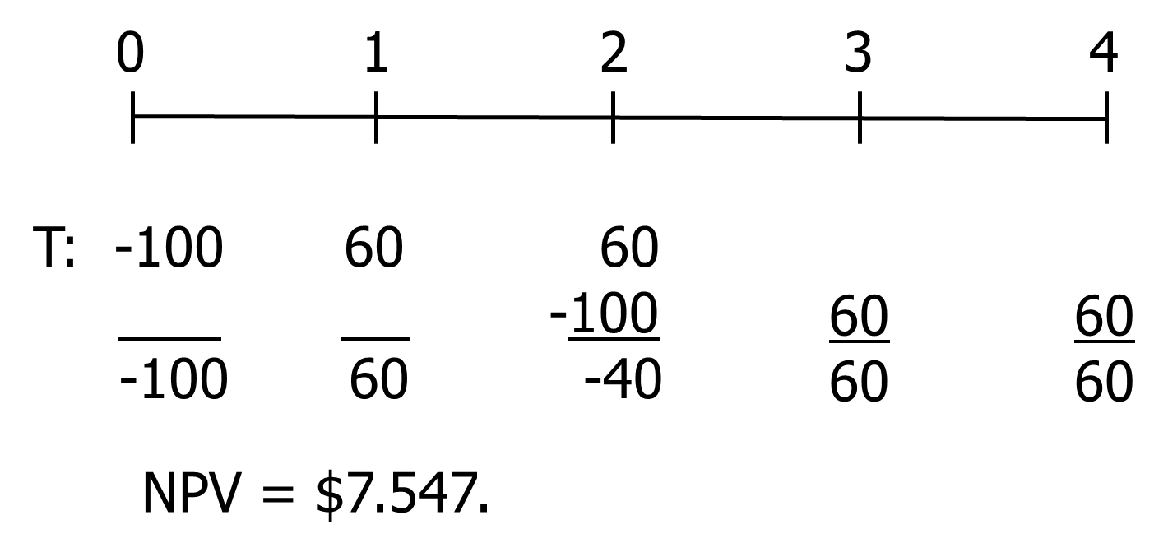
Replacement Chain Approach: F with Replication ($ thousands)

Slide 56
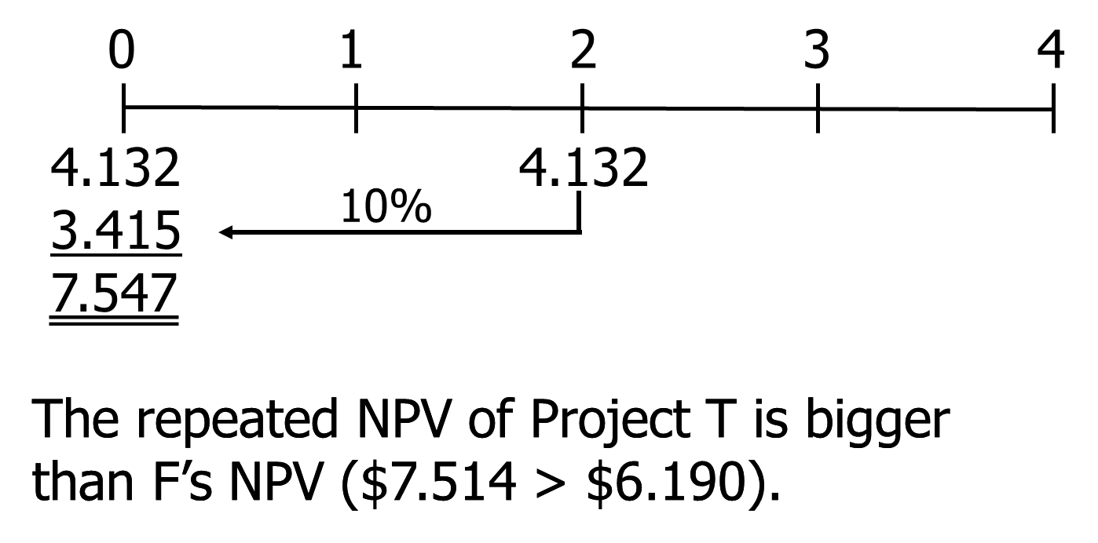
Or, Use NPVs

Slide 57
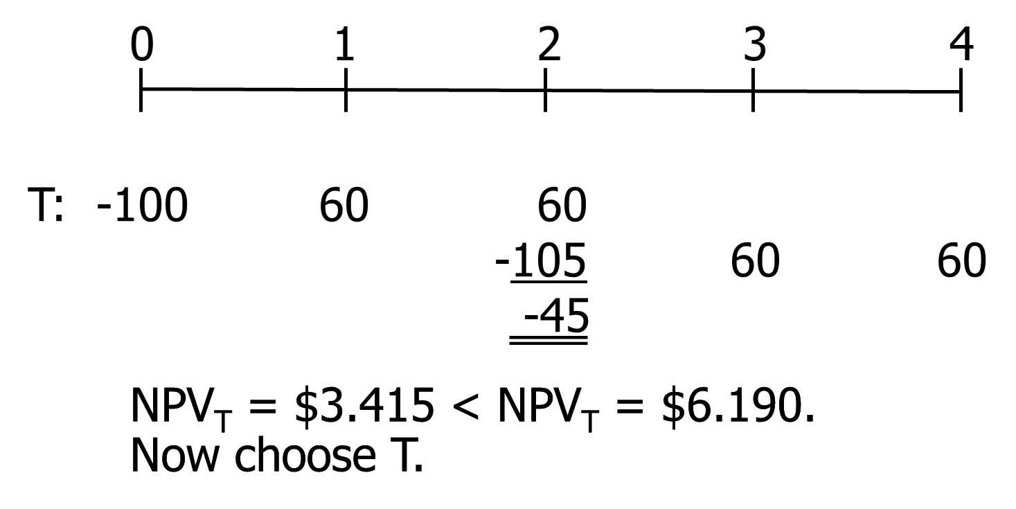
Suppose the cost to repeat T in two years rises to $105,000?

Slide 58
Economic Life versus Physical Life (1 of 2)
Consider another project with a 3-year life.
If terminated prior to Year 3, the machinery will have positive salvage value.
Should you always operate for the full physical life?
See next slide for cash flows.

Slide 59
Economic Life versus Physical Life (2 of 2)
Year | CF | Salvage Value
0 | -$5,000 | $5,000
1 | 2,100 | 3,100
2 | 2,000 | 2,000
3 | 1,750 | 0

Slide 60
CFs Under Each Alternative (000s)
Years: | 0 | 1 | 2 | 3
1. No termination | -5 | 2.1 | 2 | 1.75
2. Terminate 2 years | -5 | 2.1 | 4
3. Terminate 1 year | -5 | 5.2

Slide 61
NPVs under Alternative Lives (Cost of Capital = 10%)
NPV(3 years) = -$123.
NPV(2 years) = $215.
NPV(1 year) = -$273.

Slide 62
Conclusions
The project is acceptable only if operated for 2 years.
A project’s engineering life does not always equal its economic life.

